Slide 1



Riding the Yield Curve
x
F. Zhao, L.C. Lacombe, R.J. Mungroop, W.F. Staring
Econometrical Case Study

Slide 2
Context & Goals
European Swap Rates (2000 - 2024)
Calculate Final Investment Value for each Maturity in Yield Curve
Parse time series data
Use five year horizon, calculate PV on final year
Reinvest coupons
Compute Descriptive Statistics from Data
Parse data
Numerical statistics
Visual statistics
Modeling
Simplify yield curves to their slopes and absolute levels (predictive variables)
Classify yields and predict best strategy
Create a machine learning model to predict best investment strategy
Date | 1Y | 2Y | 3Y | 4Y | 5Y
2000-01-03 | 0.040 | 0.045 | 0.049 | 0.051 | 0.052
… | … | … | … | … | …
2024-09-23 | 0.028 | 0.024 | 0.023 | 0.023 | 0.023
Source: Achmea
Present Value (2000 - 2019)
Date | 1Y | 2Y | 3Y | 4Y | 5Y
2000-01-03 | 118.3 | 121.5 | 124.1 | 128.2 | 129.2
… | … | … | … | … | …
2019-09-23 | 105.20 | 103.00 | 104.88 | 104.94 | 97.92
Source: Group 9 using Achmea data

Slide 3
Approach
Tools
R with RStudio
- We are all experienced
- Easy to collaborate
- Powerful libraries
- Statistics
- Visualization
- Modeling
- Code blocks
- Increased legibility
- Efficient
Team Work
NO Divide & Conquer
- Each part done individually
- All versions fused into one
- Best product possible
- Unified understanding
- Biweekly meetings
- Check in
- Refine
- Update goals
Timeline
- Investment Value & Stats.
- Goal: Jan 12
- Realized: Jan 12
- Modeling
- Goal: Jan 22
- Realized: Jan 25
- Presentation & Report
- Goal: Jan 28
- Realized: Jan 29

Slide 4
Methodology - Descriptive Statistics
Calculate Investment Value
Research
Online
Given excel spreadsheet
Develop Four Versions
Choose Best Approach
Improve chosen approach
Efficiency over mimicry
See pseudocode for chosen approach
Descriptive Statistics
Individually Brainstorm Best Statistics
Agree on and Reduce to Most Impactful
Most descriptive
Clearest and best looking
See next slide for final statistics
Investment Value Calculation Pseudocode
FOR first date to final date (last year - 5 years)
FOR maturity investment strategy 1 to 5
WHILE current day is less than final year
Get bond rate for current date
IF investment at current date will mature past final year store bond rate of shorter maturity
Distribute coupons across the upcoming years
Call function to jump to next year
IF needed, go back to last trading day
Calculate Present Values IF needed
Calculate final investment
Store results
Alternative Methodologies
Excel Mimicry (Rishèn)
Real Life Mimicry (Fanyi)

Slide 5
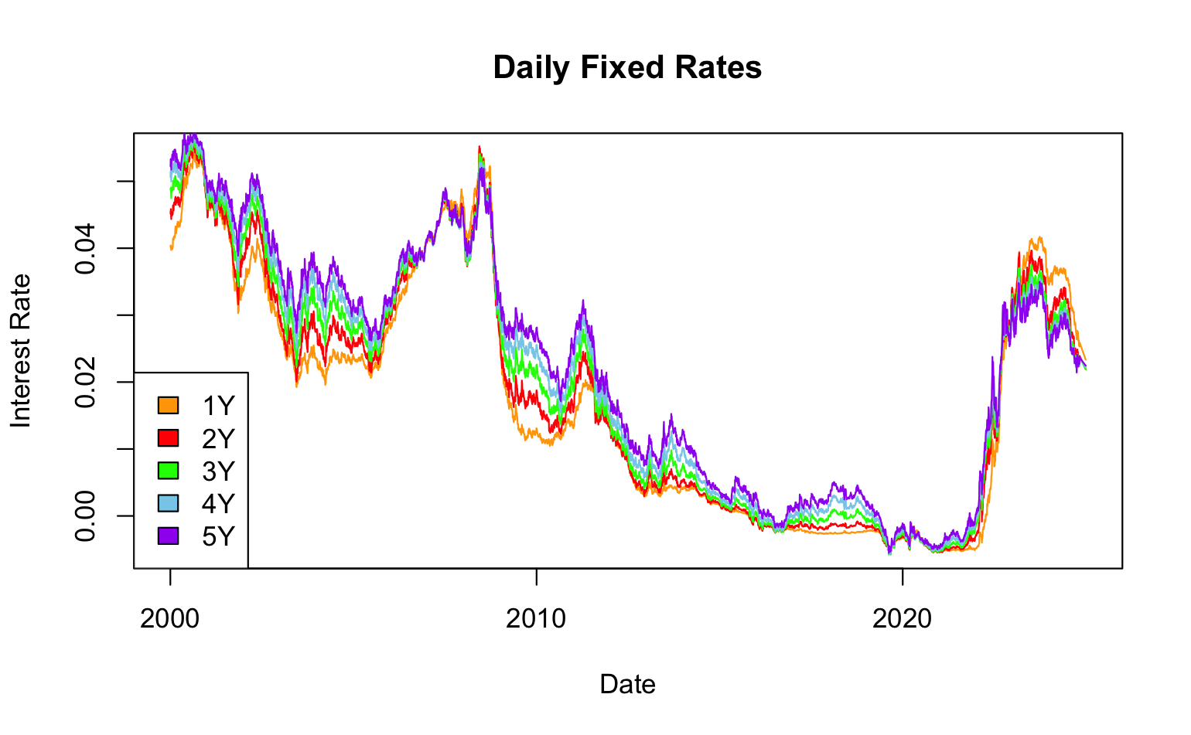
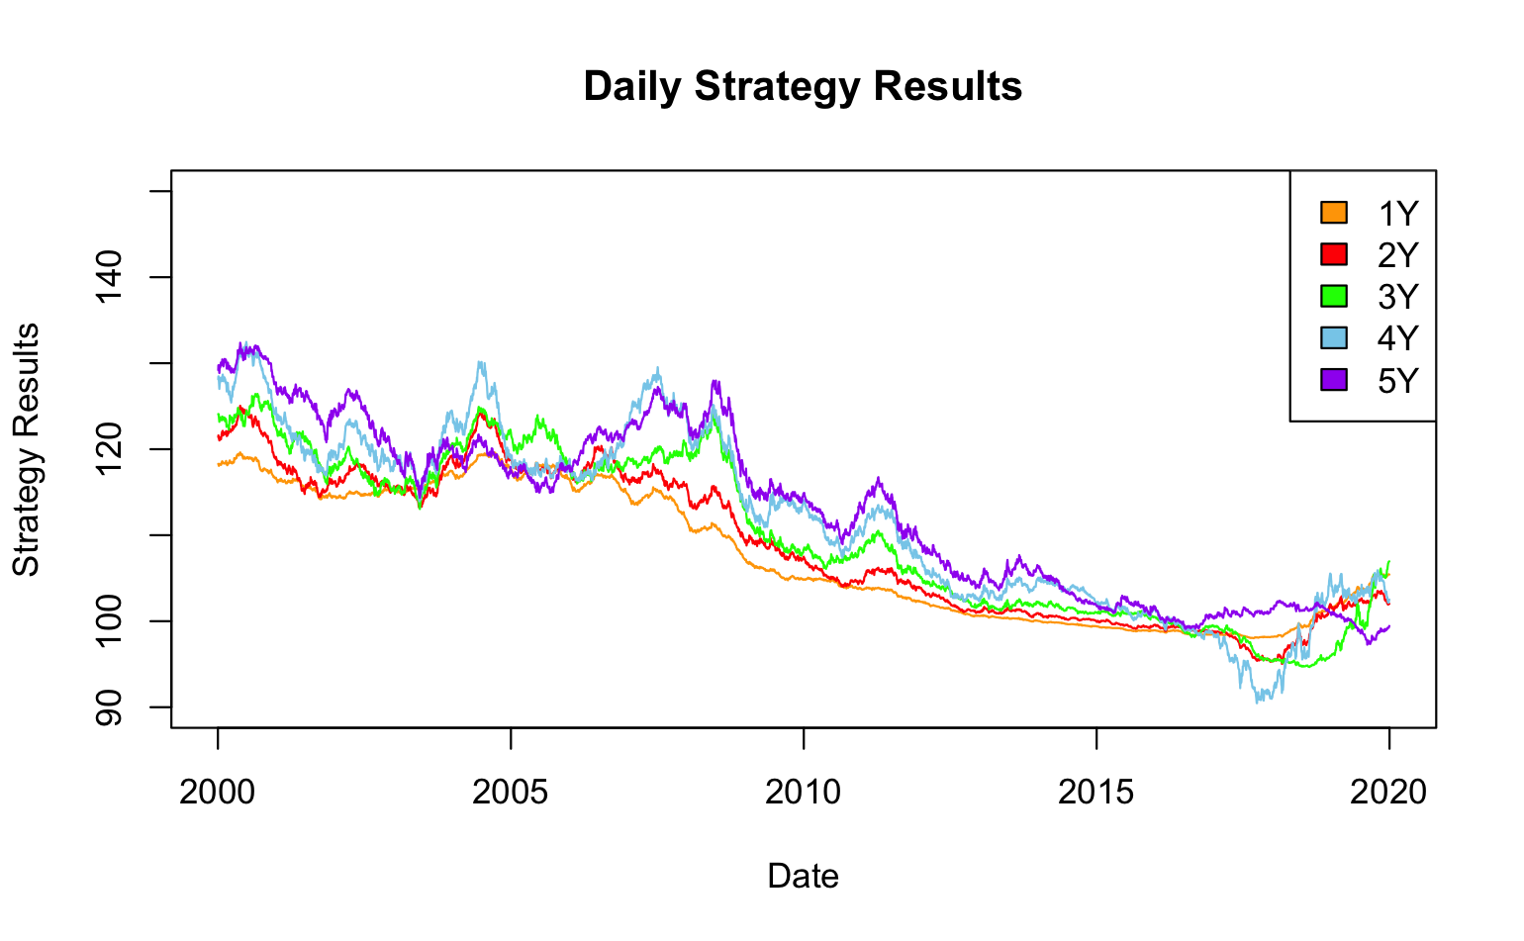
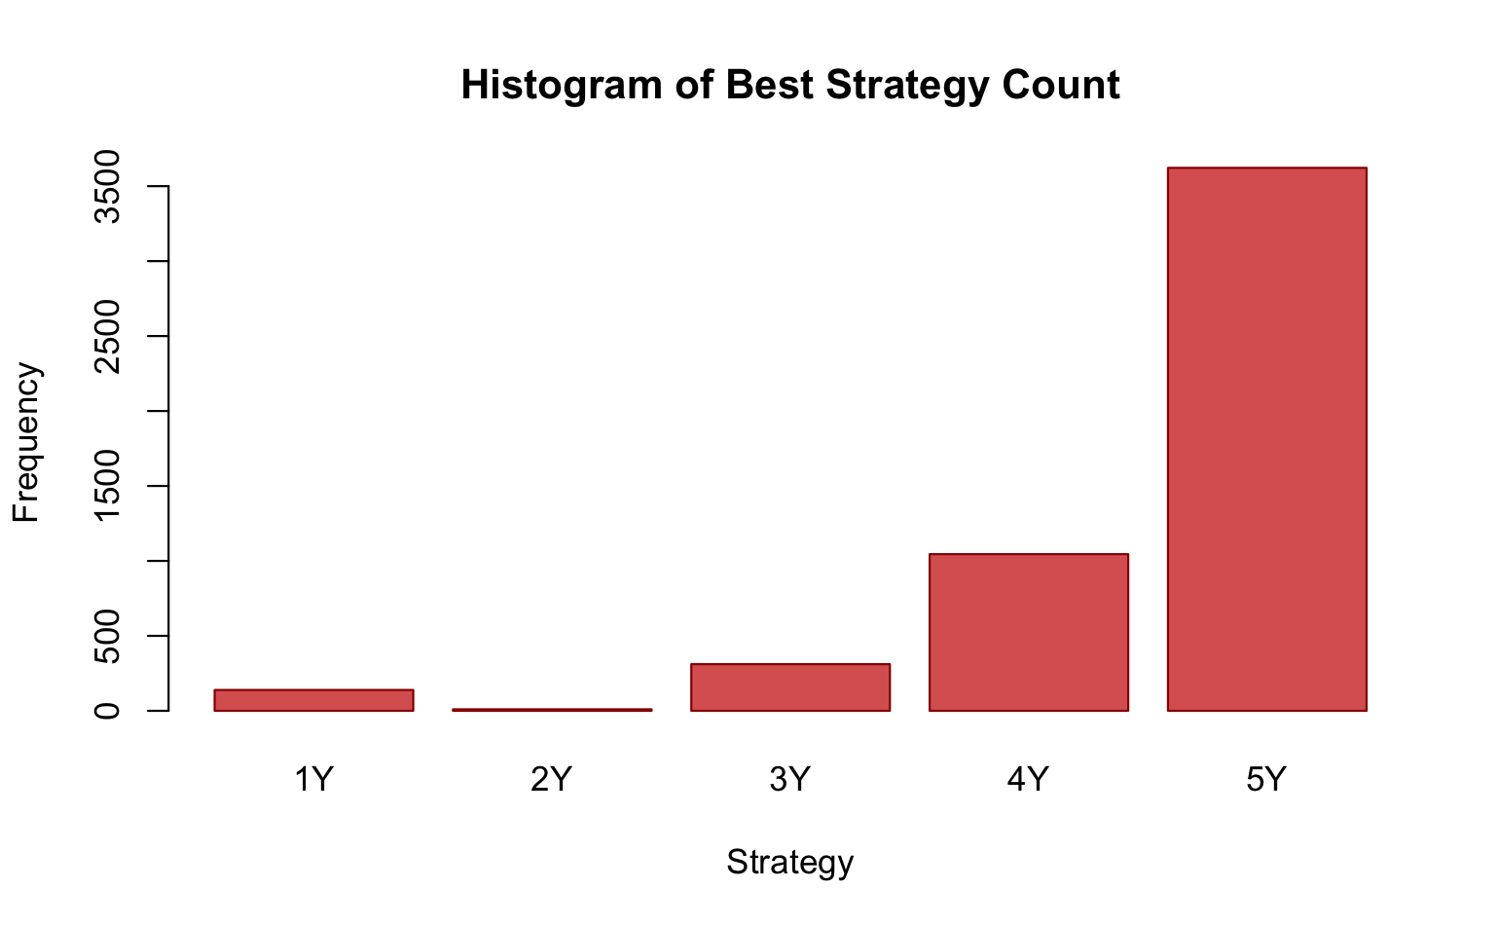
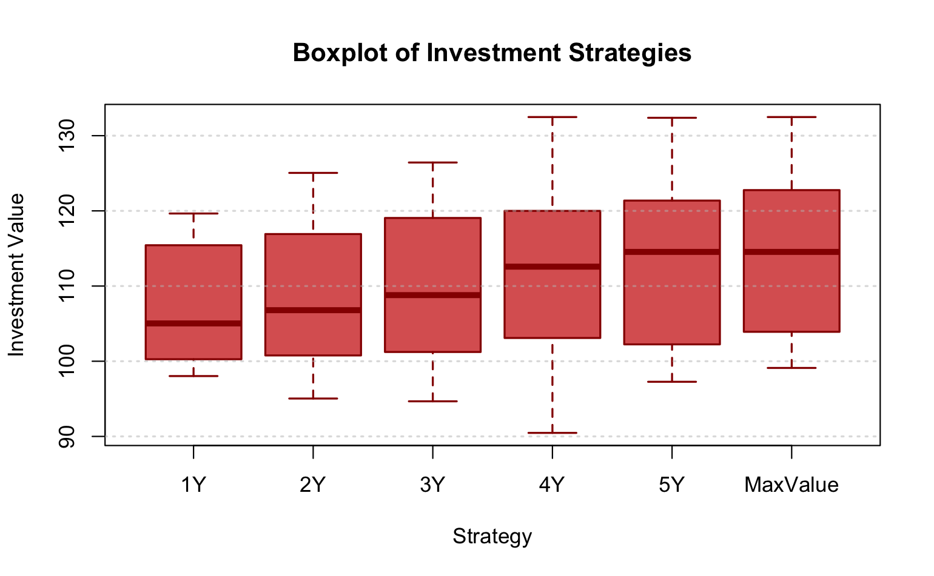
Results - Descriptive Statistics

Slide 6
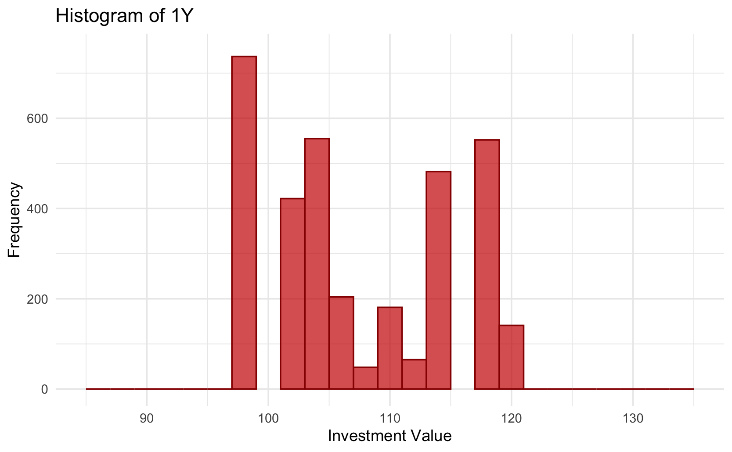
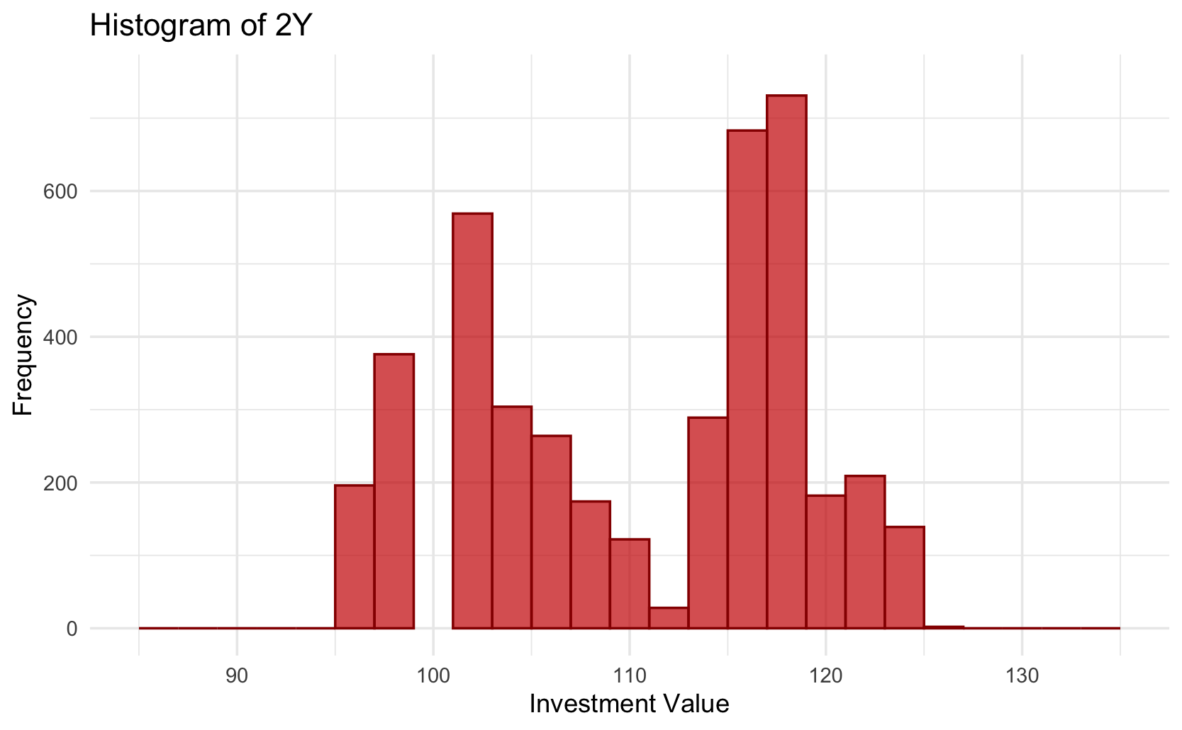
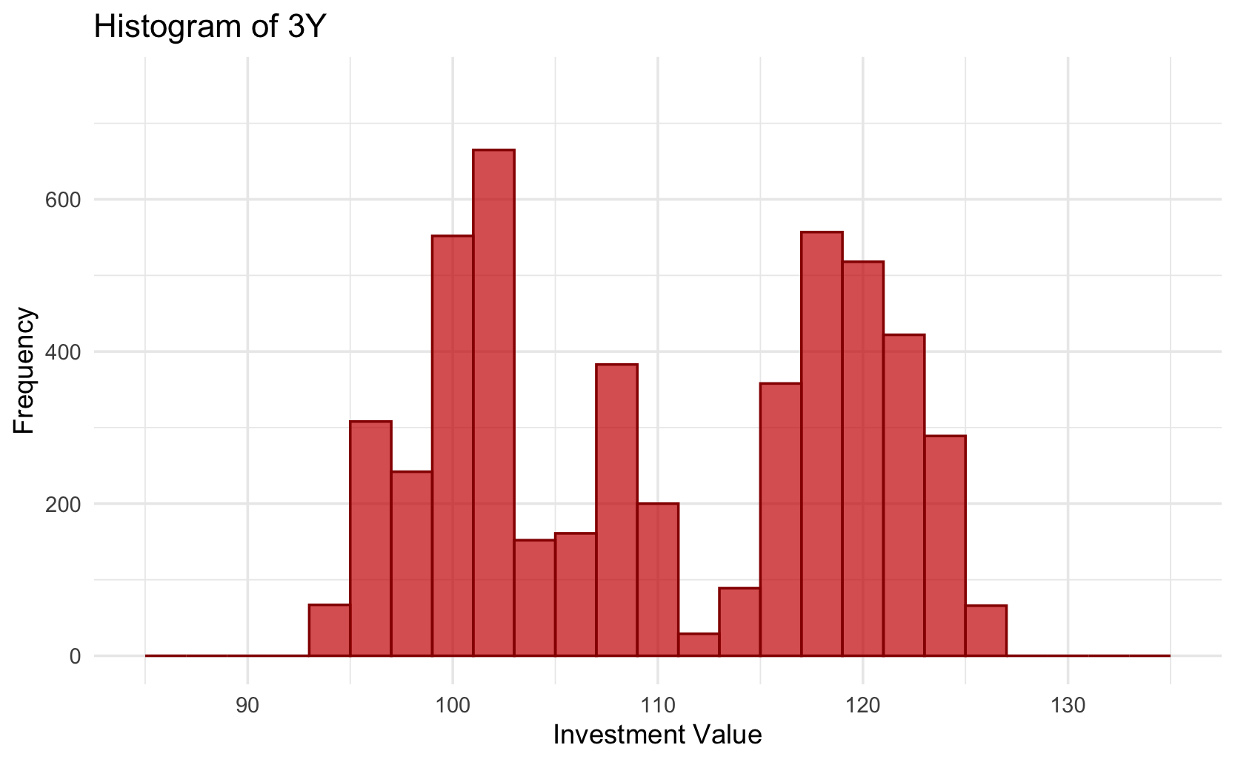
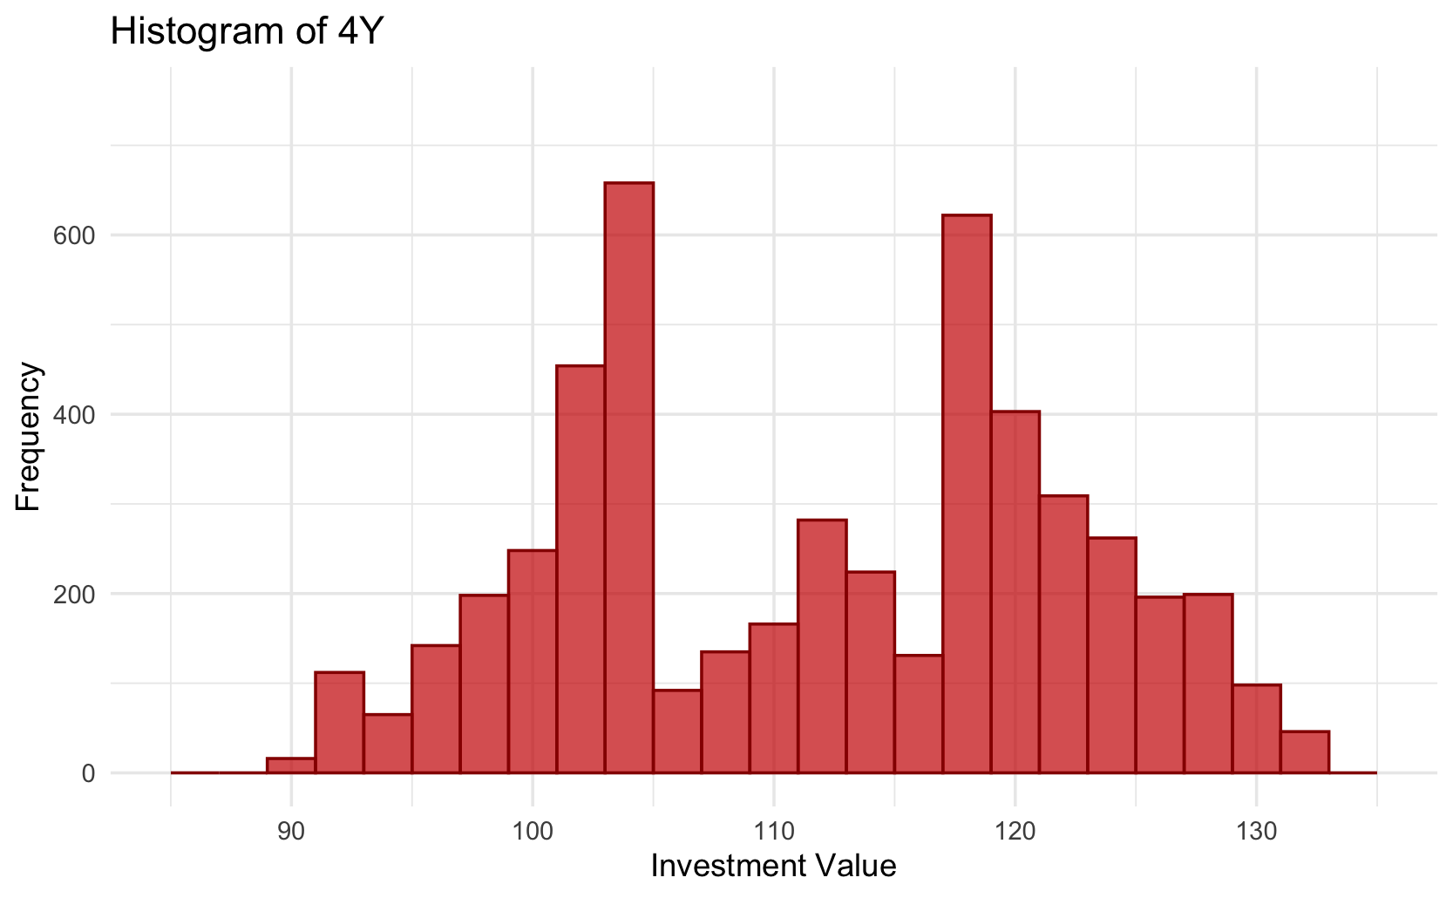
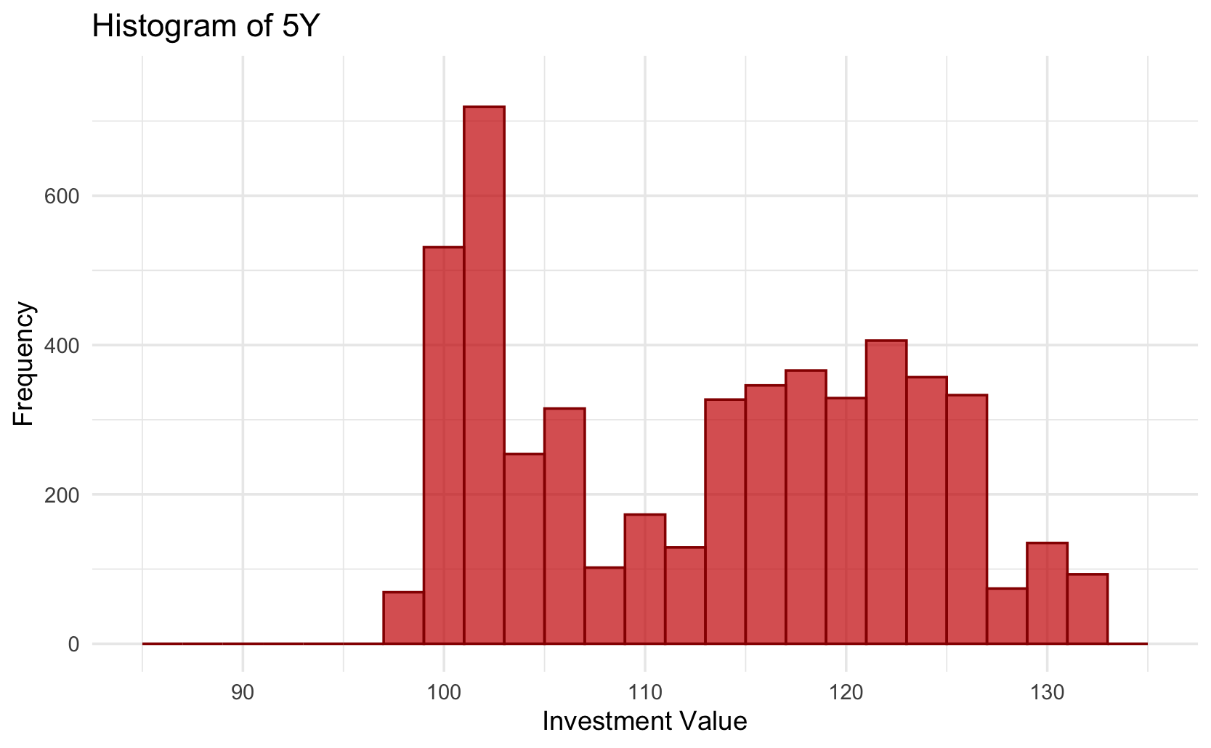
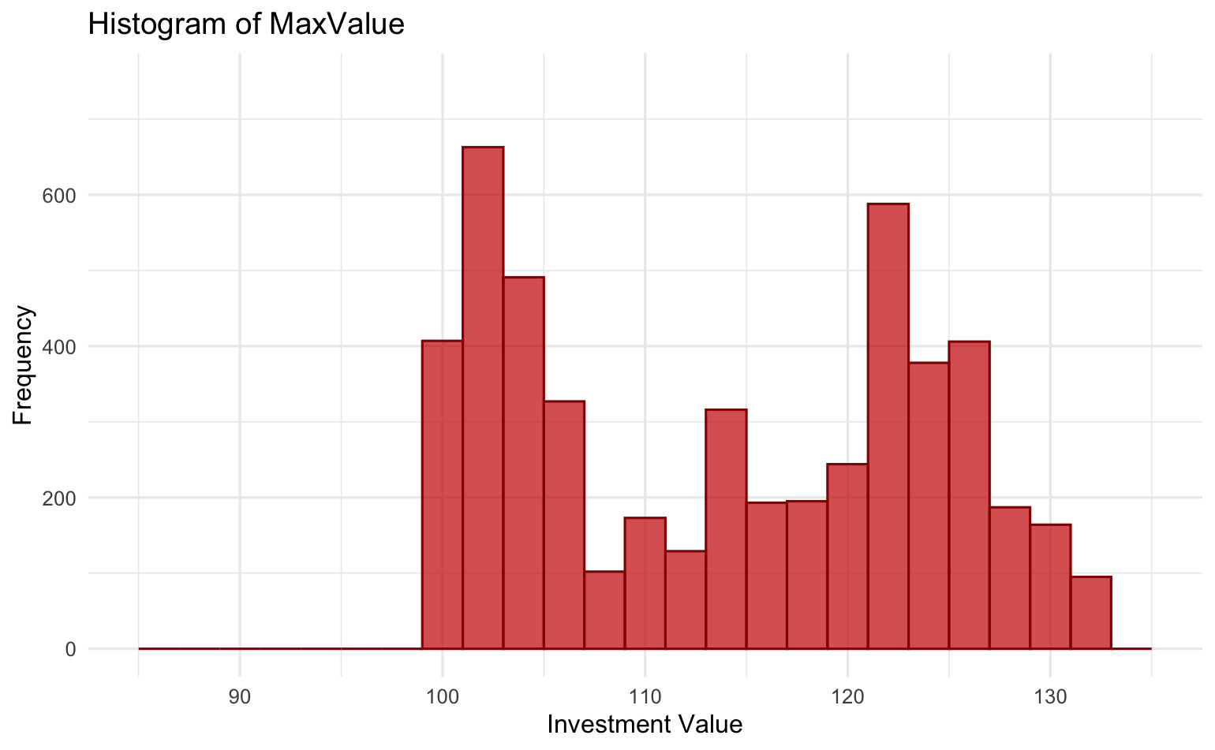
Results - Descriptive Statistics

Slide 7
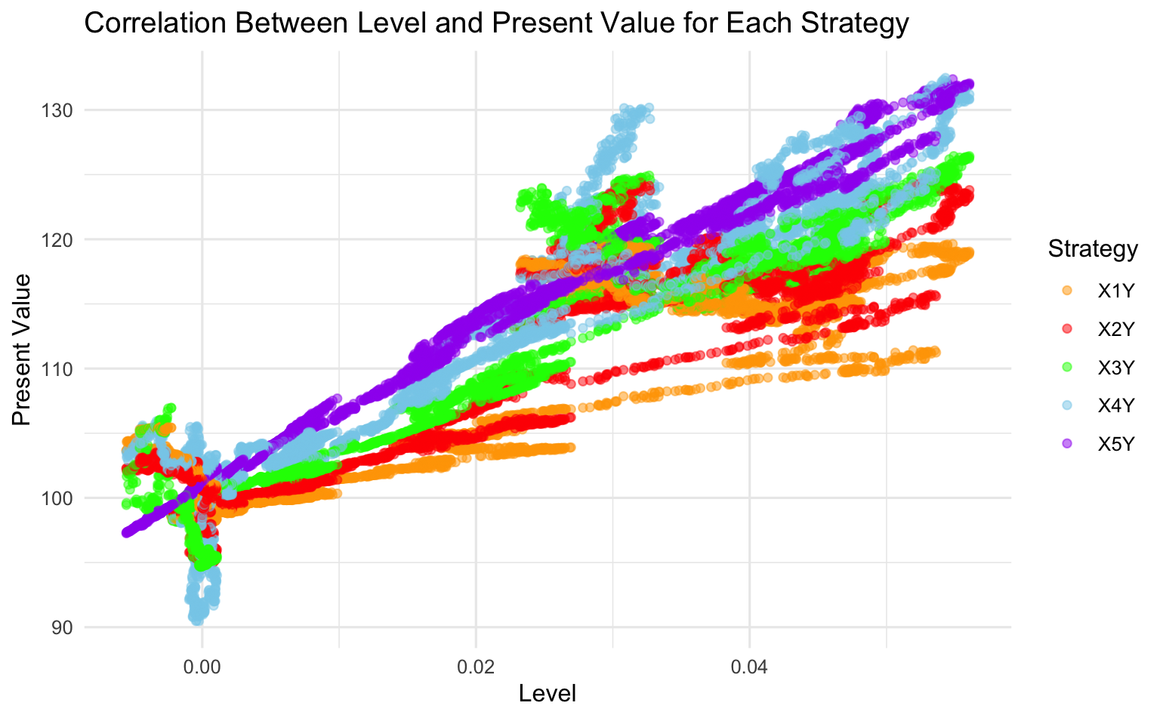
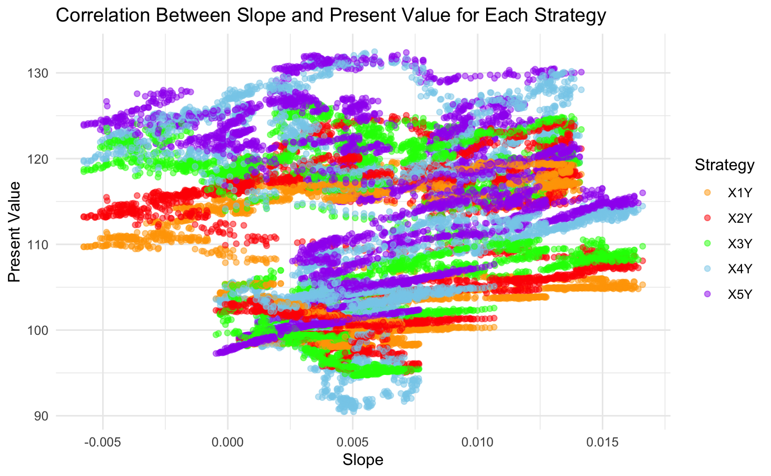
Modeling - Predictors
Absolute Level as a Predictor
Slope as a Predictor
Slope and Level Correlation with All Yield Curve Strategies
 | 1Y | 2Y | 3Y | 4Y | 5Y
Level | 0.88 | 0.91 | 0.94 | 0.94 | 0.99
Slope | 0.18 | 0.17 | 0.11 | 0.14 | 0.13
Source: Group 9 using Achmea data
Notes:
Briefly mention how Achmea recommended we use slope and absolute level as predictive variables
Looking at these plots we can expect level to have more predictive power as there is greater correlation

Slide 8
Methodology - Modeling
Learning Phase
Research (Websites, Videos, AI)
What models are available/applicable
Development & Refinement Phase
Develop Four Versions
Random Forest (RF) using large window size
RF with data preparation (PCA & SMOTE)
KNN
Determine Best Approach
Meetings
Case designer (Michiel Hopman)
Office hours (Barend Spanjers)
Additional research & internal meetings
Develop RF with large window size
Additionally develop KNN to compare
RF - In Sample Testing
Fit RF model
Target Variable: Best Strategy
Predictor Variables: Absolute level & slope
Dataset: All available data
Tree Count: 64
Make prediction on all data and report statistics
RF - Out of Sample Testing (Rolling Window)
Define window size, prediction size, prediction gap
3024, 10, 1260
Calculate number of testing windows
FOR each testing window
Extract data windows for fitting & prediction
Fit RF model IF 2+ best strategies in data
Dataset: Window of fitting data
Make predictions on prediction data with model
Report statistics
Notes:
Learning phase has its own section as unlike previous parts we needed to learn a lot more
Develop Four Versions has alternative methodologies
Mention the extensive back and forths about which models to use and how to tune them

Slide 9
Results - Modeling
In Sample Test Confusion Matrix
Out of Sample Test Confusion Matrix
Predicted / Actual | 1Y | 2Y | 3Y | 4Y | 5Y
1Y | 139 | 0 | 0 | 0 | 0
2Y | 0 | 10 | 0 | 0 | 0
3Y | 0 | 0 | 311 | 0 | 0
4Y | 0 | 0 | 0 | 1044 | 1
5Y | 0 | 0 | 0 | 1 | 362
Predicted / Actual | 1Y | 2Y | 3Y | 4Y | 5Y
1Y | 0 | 0 | 0 | 0 | 0
2Y | 0 | 0 | 0 | 0 | 0
3Y | 0 | 0 | 0 | 0 | 0
4Y | 1020 | 0 | 215 | 210 | 0
5Y | 280 | 0 | 0 | 1480 | 5135
Source: Group 9 using Achmea data
Source: Group 9 using Achmea data
Accuracy: 99.96% MeanDecreaseGini: Level: 1427
Slope: 907
Level Power: +57%
Accuracy: 64.09%
MeanDecreaseGini: Level: 823
Slope: 592
Level Power: +39%
Notes:
Very briefly explain in sample results
More time to explain out of sample
Comment on MeanDecreaseGini (mostly aligns with correlation plots)

